Slide 1

Open Source Software
DVD FLICK

Slide 2
Report based on:
Idea
What problem does it solves?
Licensing Model
Intend behind making it open source
Monetization Model
Popularity
Impact

Slide 3
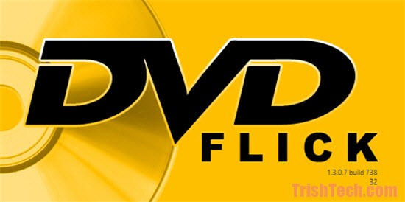
Aim: To identify any open source software and create detailed report about it(DVD Flick).

Slide 4
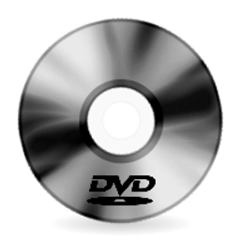
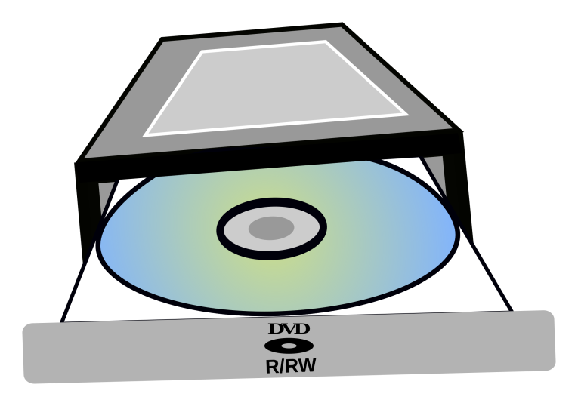
Idea
It aims to be a simple but at the same time powerful DVD Authoring tool. It can take a number of video files stored on your computer and turn them into a DVD that will play back on your DVD player, Media Center or Home Cinema Set. You can add additional custom audio tracks, subtitles as well as a menu for easier navigation.

Slide 5
Features
Burn near any video file to DVD
Support for over 45 file formats
Support for over 60 video codecs
Support for over 40 audio codecs
Easily add a menu
Add your own subtitles
Easy to use interface
Burn your project to disc after encoding
Completely free without any adware, spyware or limitations

Slide 6
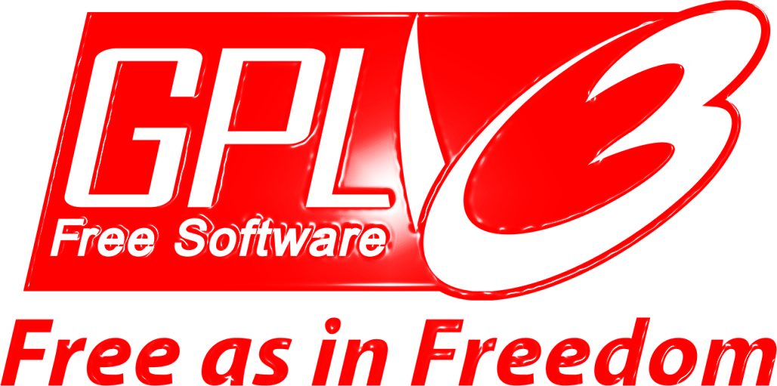
Licensing Model
DVD Flick is an open source DVD authoring application for Windows developed by Dennis Meuwissen and released under the GNU General Public License which was originally written by Richard Stallman of the Free Software Foundation(FSF) for the GNU Project
The GPL is a copyleft license, which means that derivative work can only be distributed under the same license terms for general use.

Slide 7

Intend behind making it Open Source
Dennis Meuwissen is a software developer and maker of an open source DVD-creation utility.
Finding an "Aha, at last" solution for thousands of movie enthusiasts everywhere isn't exactly easy - in fact, many reviewers note that until coming across Meuwissen's DVD Flick, they had met with frustration when trying to find a program that will actually make DVDs that can be played on a DVD player.
The fact that Meuwissen not only developed such a product but offers it for free says as much about the man's design talent as it does his sense of commitment as a developer.

Slide 8

Monetization Model
As Dennis Meuwissen developed and offered the software for free, his intent was not to make money but to help the frustrated people to find a program that would be able to run on a DVD player by encoding DVD’s by software tools.
He just puts a review box in his official website and asks for the donations if you like the software and to contribute as much as possible by your own wish, to develop the software and add more features in it.
Even it prompts adds in between and from these adds he gets paid by the companies who request him to give their adds in his softwares (www.dvdflick.net).

Slide 9
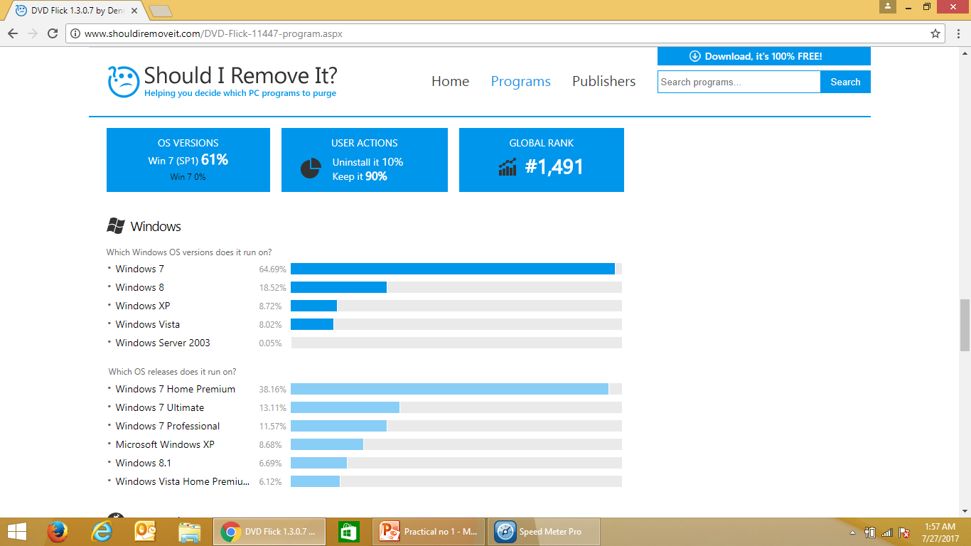
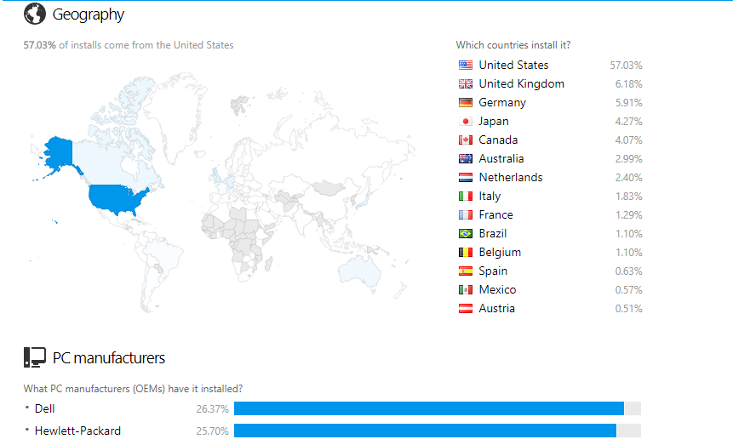
Popularity

Slide 10
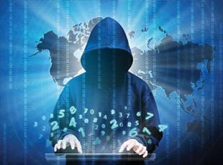
Impact
Since their were no software programs invented before DVD Flick to play DVD’s that can be played on DVD player, the people got a FREE AND OPEN SOURCE Software and then the development in programs got a boost and now we all have a latest and best quality softwares available for free on web.
Any kind of file formats may be their you can convert it into a DVD and play it on your DVD player, Media Center or Home Cinema Set.
OVER 40-60 types of codecs/formats are easily converted into DVD by simple use of this software burning techniques with a menu and good interface.

Slide 11

Conclusion
The study and report of DVD flick as a open source software has been done successfully.
THANK YOU
PPT By:- Aamin Malik

